Slide 1
InEExS – Innovative Energy (Efficiency) Service Models for Sector Integration via Blockchain
IISA 2025
5th International Workshop on AI & Data Analytics in the Energy Sector
Filippos Anagnostopoulos, IEECP
Project Coordinator

Slide 2
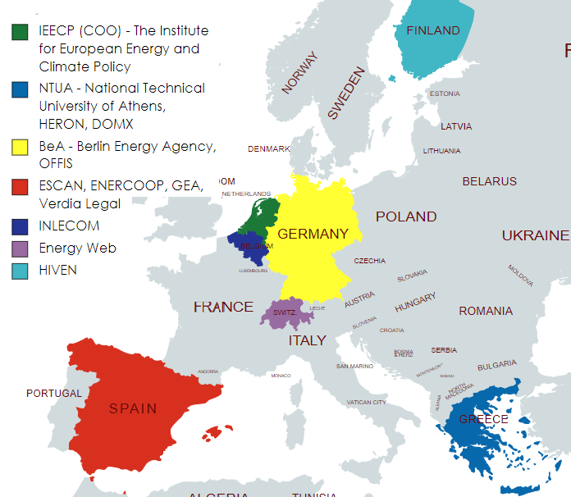
InEExS
Project name | Innovative Energy (Efficiency) Service Models for Sector Integration via Blockchain
Topic | LIFE-2021-CET-SMARTSERV
Duration | November 2022 – February 2026
Partners | 12 Organizations: a utilities, an energy agencies, an energy cooperatives, technology providers, university labs and research institutes
Grant | 1.94M EUR

Slide 3

InEExS – in summary
The core concept of InEExS is the deployment of integrated energy services across sectors and carriers, and the tokenisation of energy saving data in a public blockchain to facilitate cooperation among market segments and actors.
InEExS improves the implementation of Energy Efficiency Directive (EED) Article 8 by supporting Obligated Parties to provide integrated service offers that enable energy savings, system efficiency and include non-energy benefits.
Notes:
The clean energy transition requires significant changes in energy generation, transmission, and consumption. Public and private market actors play a crucial role in promoting new technologies and shifting business practices. While progress has been made, barriers in economics, politics, regulations, technology, and behavior hinder the adoption of energy efficiency and renewable energy technologies. Overcoming these barriers requires developing new business models and markets for sustainable energy services, improving existing processes and value chains, and leveraging technologies like IoT, smart meters, AI, and DLT to create an integrated energy system.

Slide 4
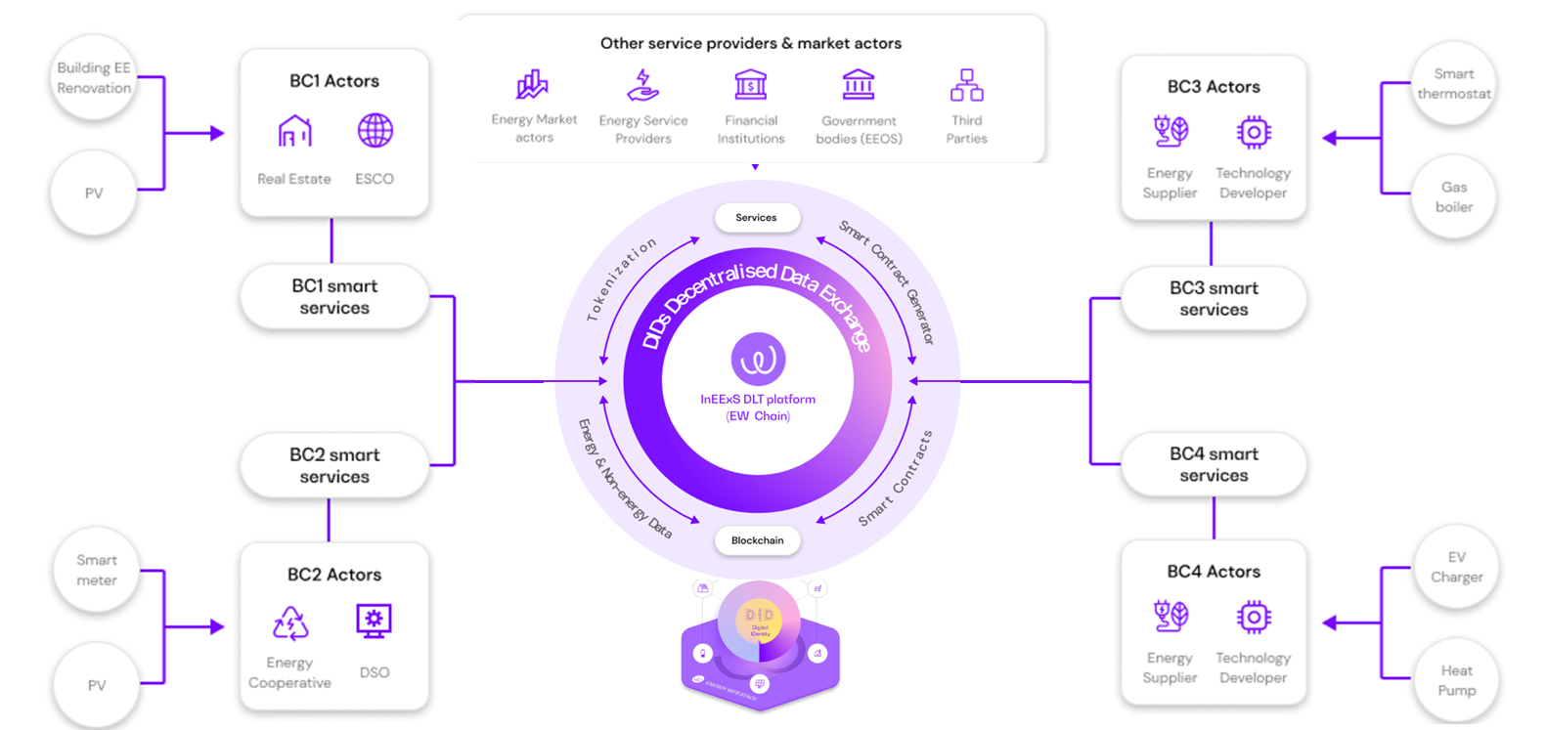
The InEExS Blockchain platform and services
Notes:
The unifying solution and major advancement of the project is the use of Distributed Ledger Technology (DLT) to support the integration of four crucial energy business cases. This architecture combines the power of the Energy Web (EW Chain) blockchain, Smart Contracts service, and Tokenization service, enabling seamless and efficient energy transactions
Blockchain platform: The Energy Web (EW Chain) blockchain platform is the an open-source, enterprise blockchain platform tailored to the needs of the energy sector.
Smart Contracts service: the Smart Contracts generator is used for bridging the physical contracts with the digital world and legally binding the contract actors to follow their commitments
Tokenization service: extension service of the EW Chain to allow token holders to monetise energy savings and flexibility,
Advanced MRV methodology for automated tracking of energy savings using energy metering equipment and IoT sensors in order to reliably report metered energy savings in the context of energy efficiency obligation schemes

Slide 5



Objectives
conceptualise and develop business models and contractual schemes for integrated and sustainable energy service offers
deploy, assess and validate the use of innovative technologies as enablers of integrated services across sectors.
roll out and replicate smart energy services
Notes:
Objective 1 aims to develop sustainable energy service offers by conceptualizing and creating business models and contractual schemes. These models will integrate energy efficiency, renewable energy, distributed energy resources, electric vehicles charging, demand response, and smart heating and cooling management. The objective also includes enhancing integration through distributed ledger technologies and smart contracts while considering market design, regulations, financing, and consumer preferences.
Objective 2 of InEExS aims to deploy and validate innovative technologies for integrated services across sectors. The project will complement sustainable technologies with digital interfaces such as IoT and mobile apps, and emphasize the use of distributed ledger technologies (DLT) for energy transactions via smart contracts and distributed identities. The aim is to tokenize energy production, flexibility, and energy savings with automated MRV. InEExS will facilitate the integration of these services with market actors and sectors beyond the original scope, validated in four Business Cases (BCs) with replication activities guiding cooperation across sectors.
Objective 3: InEExS aims to replicate its smart energy services by engaging with product developers, energy system actors, start-ups, and policymakers. The objective is to transfer expertise, business models, and policy roadmaps to break market barriers and promote the adoption of smart technologies. Workshops, webinars, capacity building, and partnerships with platforms and projects will facilitate knowledge transfer to stakeholders.

Slide 7
Filippos@ieecp.org

Slide 8
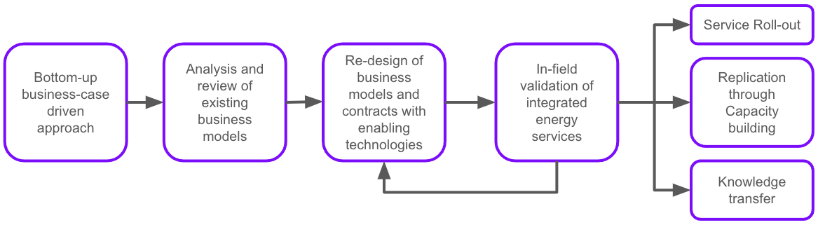
Intervention logic
Notes:
The InEExS project follows an intervention logic that aims to accelerate the development and deployment of integrated smart energy services. The key components of the methodology are seen in the present graph:
C1. Bottom-up business-case driven approach: The project focuses on diverse business scenarios that represent different sectors and energy services. These scenarios involve various stakeholders and technologies, providing a comprehensive understanding of barriers, needs, and potential solutions.
C2. Analysis and review of existing energy services and models: The project analyzes the energy services offered in the business cases to characterize their unique business models, legal requirements, cost structures, revenue streams, and contributions to energy and non-energy benefits.
C3. Redesign of business models and contractual schemes with enabling technologies: The existing business models are redesigned to ensure sustainability, incorporate new stakeholders, and create new revenue streams. Distributed Ledger Technologies (DLT) are used to facilitate secure data exchange, support smart contracts, and enable the integration of Measurement Reporting Verification (MRV) methodologies. The aim is to provide certified energy savings and digitize contractual schemes .
C4. In-field validation of sector-integrating energy services: The developed integrated energy services are deployed, tested, and validated in real-world conditions. This phase involves continuous feedback loops, allowing for the improvement and evolution of service design based on real-world feedback.
C5. Roll-out, Replication, and Knowledge Transfer: The project aims to replicate and disseminate the outcomes and lessons learned. This includes rolling out services to direct customers, facilitating iterative exchanges between stakeholders through workshops and capacity-building events, and actively producing recommendations for policymakers and business leaders. The objective is to overcome market barriers and promote the widespread adoption of viable business models.

Slide 9
5 Business cases
Energy Performance Contracting with Pay4Performance guarantees (Berlin, Germany)
Improved self-consumption of distributed energy resources in Energy Cooperatives (Crevillent, Spain)
Energy efficiency and flexibility services for legacy natural gas boilers (5 Greek cities: Athens, Thessaloniki, Larisa, Trikala, Volos)
Smart energy management for EV chargers and electricity-based HVAC appliances (Sweden)
Decentralized Energy Efficiency Power Plant (DEEPP) (conceptual)
InEExS is testing five innovative services, their business models and contracts, and linking them through metered energy savings and a blockchain platform

Slide 10
Energy Performance Contracting with Pay4Performance guarantees
Area: Berlin, Germany | Stakeholders: Berlin Energy agency Real estate company (berlinovo) ESCO (TBD through public tender)
Participants: 2 big blocks of residential apartments | Customer portfolio: berlinovo manages the portfolio of 22 real estate funds with 246 properties (99.5% state owned)
Smart services: EPC contracts with Pay4Perfornance guarantees based on metered savings Energy efficiency upgrade of electricity-based HVAC systems | Infrastructure: Smart meters Distributed PVs and batteries Heat-pumps EV chargers
Potential DLT platform usage: EED EEOSs, Smart EPC contracts with Pay4Performance guarantees
Notes:
Introduction:
BC1: Energy Performance Contracting (EPC) with Pay4Performance guarantees in Berlin, Germany.
This BC brings together key stakeholders and participants to showcase the benefits of EPC and innovative financing models in the real estate sector.
Stakeholders:
Berlin Energy Agency:
Key player in promoting energy efficiency and sustainability in Berlin.
Facilitates the project and provides expertise in energy management and policy support.
Real Estate Company (berlinovo):
Manages the portfolio of 22 real estate funds with 246 properties, predominantly owned by the state.
Demonstrates commitment to sustainability and aims to optimize energy performance across their properties.
Energy Service Company (ESCO) (TBD through public tender):
Selected ESCO will be responsible for implementing energy efficiency measures and managing the EPC project.
Brings technical expertise, project management, and financing solutions to achieve energy savings.
Demo sites:
Two publicly owned big blocks of residential apartments are engaged in this project.
These buildings are representative of berlinovo’s portfolio and offer a prime opportunity for energy efficiency upgrades and optimisation
Smart Services:
EPC Contracts with Pay4Performance Guarantees:
Innovative contracting model that links payments to actual metered energy savings.
Provides financial security and ensures a shared focus on achieving energy efficiency targets.
Energy Efficiency Upgrade of Electricity-Based HVAC Systems:
Focuses on improving the efficiency of heating, ventilation, and air conditioning (HVAC) systems in the residential blocks.
Upgrades will be tailored to the specific needs of each building, resulting in significant energy savings.
Infrastructure:
Smart Meters:
Installed to monitor and measure energy consumption in real-time.
Enable accurate measurement and verification of energy savings, facilitating the Pay4Performance guarantees.
PVs and Batteries:
Integration of renewable energy sources to reduce reliance on grid-supplied electricity.
The excess energy generated by the photovoltaic (PV) systems is stored in batteries for later use.
Heat Pumps:
Efficient heating that will utilizes renewable energy sources to provide space heating and hot water.
EV Chargers:
Installation of electric vehicle (EV) charging infrastructure to promote sustainable mobility and support the transition to electric transportation
Potential DLT Platform Usage:
EED EEOSs (Energy Efficiency Obligation Schemes):
Automated quantification and verification of energy savings for alternative measures.
Blockchain-based technology ensures transparency and trust in the measurement and reporting of energy savings.
Smart EPC Contracts with Pay4Performance Guarantees:
All payments among engaged parties, including the ESCO and building owner, are linked to metered energy savings.
Blockchain-based platform facilitates secure and automated transactions, streamlining the payment process.
Overall:
this project demonstrates the potential for significant energy savings through the use of innovative financing models, smart services, and the integration of renewable energy technologies,

Slide 11
Improved self-consumption of distributed energy resources in Energy Cooperatives
Area: Crevillent, Spain | Stakeholders: ENERCOOP: Energy Cooperative, Supplier, DSO and consumers
Participants: 65 households of ENERCOOP members | Customer portfolio: >15.000 consumption points of ENERCOOP
Smart services: Shared PV ToU tariffs Energy advisory program with behavioural interventions | Infrastructure: Smart meters and smartphone Collective PV EV chargers and battery storage
Potential DLT platform usage: Smart contracts to increase transparency of energy bills and to self-consumption Energy tokens to incentivize community members to increase self-consumption, Automated quantification and verification of energy savings
Notes:
In this case, we explore how ENERCOOP, an Energy Cooperative in Crevillent, Spain, is improving the way energy is consumed and shared among its members.
[Stakeholders]
ENERCOOP serves as the driving force behind this demo, acting as an energy cooperative, supplier, and distribution system operator (DSO).
ENERCOOP serves over 15,000 consumption points, including residential, commercial, and industrial customers.
The project focuses on improving self-consumption among these customers, promoting a shift towards cleaner energy sources.
[ Participants]
The project engages 65 households, who are members of ENERCOOP, to collectively enhance self-consumption of energy resources.
[Smart Services]
ENERCOOP enables its cooperative members to benefit from shared photovoltaic (PV) installations without requiring any upfront investment.
By harnessing solar energy collectively, the cooperative increases self-consumption while reducing reliance on the grid.
To incentivize consumers, ENERCOOP will implement Time-of-Use tariffs, encouraging members to maximize their self-consumption during periods of low electricity prices.
An energy advisory program, integrated into a smartphone application, will provide personalized insights and behavioral interventions (Nudges).
Consumers receive guidance on optimal electricity usage, encouraging them to consume electricity during low-price periods.
[Infrastructure]
Smart meters and a smartphone application are provided to all community members, enabling real-time monitoring and control of energy consumption.
The demo site already has a collective photovoltaic (PV) installation of 100 kW, and an additional 100 kW expansion is currently under development.
Four electric vehicle (EV) chargers and a small battery storage system (242 kWh) are available to support local energy management.
[DLT Platform Usage]
The demo site will employ the Blochchain platform for enhanced energy management.
Smart contracts will be implemented to increase transparency in energy bills and enable efficient self-consumption.
Smart contracts incentivize end consumers based on achieved energy efficiency, encouraging sustainable practices.
Energy tokens are introduced to incentivize community members to increase their self-consumption, fostering a culture of energy awareness and optimization.
[Article 7 - Automated Quantification and Verification]
The business case demo site utilizes automated quantification and verification of energy savings.
This automated process simplifies administrative procedures and ensures accurate tracking of the achieved energy savings.
[Benefits for the members of the energy community]
Increased Self-Consumption: Through real-time monitoring and control, community members optimize their energy consumption patterns, reducing reliance on the grid and maximizing renewable energy usage.
Cost Savings: Improved self-consumption and energy efficiency measures lead to reduced energy bills, resulting in significant cost savings for community members.
Improved Sustainability: By maximizing renewable energy self-consumption, the community reduces carbon emissions and contributes to a cleaner environment.
Engaged Community: The use of innovative technologies and incentive mechanisms fosters community engagement and awareness of energy consumption habits.

Slide 12
Energy efficiency and flexibility services for legacy natural gas boilers
Area: 5 main Greek cities (Athens, Thessaloniki, Larisa, Trikala, Volos) | Stakeholders: Energy supplier (HERON) Technology developer (domX)
Participants: 20 retail HERON consumers | Customer portfolio: >20.000 retail natural gas consumers of HERON
Smart services: Energy efficiency for space heating Real-time flexibility Remote boiler technical support | Infrastructure: Smart IoT controller Smart electricity meters Smartphone application Cross vector energy management platform (electricity-gas)
Potential DLT platform usage: Automated quantification and verification of energy savings for the supplier’s EEOS Smart contracts Energy tokens
Notes:
This business case demo site, is showcasing energy efficiency and flexibility services for legacy natural gas boilers.
The demo targets five Greek cities: Athens, Thessaloniki, Larisa, Trikala, and Volos.
[Stakeholders]
HERON is the energy supplier responsible for providing gas and electricity to consumers.
domX is the technology developer responsible for designing and implementing the smart energy solutions.
[Participants]
Our project involves 20 retail HERON consumers who currently use legacy natural gas boilers
These participants will benefit from the energy efficiency and flexibility services provided.
[Customer Portfolio]
HERON has a customer portfolio of over 20,000 retail natural gas consumers.
The project aims to offer energy-saving solutions to a wide range of customers.
[Smart Services]
Energy Efficiency Improvement:
By leveraging real-time weather data and forecasts, we aim to achieve up to 35% energy efficiency improvement for space heating scenarios.
This will result in significant cost savings for participants and a reduced carbon footprint.
Real-time Flexibility:
Participants will offer real-time flexibility to HERON by automatically adjusting their energy consumption while respecting user comfort limits.
This flexibility helps balance the grid and contributes to a more reliable and sustainable energy system.
Remote Boiler technical support:
The smart IoT controller enables remote detection of boiler faults, allowing for timely maintenance.
This ensures optimal performance and reduces downtime.
[ Infrastructure]
Smart IoT Controller: monitors and controls the space heating systems, optimizing energy consumption.
Smart Electricity Meters: provide accurate and real-time data on energy consumption, enabling better control and management.
Smartphone Application:includes built-in nudging features to encourage energy-saving behaviors and enhance user engagement.
The energy management platform integrates electricity and gas data to enable holistic energy management and optimization.
[Potential DLT Platform Usage]
Article 7: Automated Quantification and Verification of Energy Savings:
The project can utilize a blockchain-based solution to automate the quantification and verification of energy savings for HERON's Energy Efficiency Obligation Scheme (EEOS).
Smart Pay4Performance Contracts:
Examine the use of smart Pay4Performance contracts based on the achieved energy savings.
These contracts ensure that consumers are rewarded for their energy efficiency efforts.
Energy Tokens:
Energy tokens can be used to incentivize participation in natural gas flexibility services.
Participants can redeem these tokens to cover costs across energy vectors, carriers, and services.

Slide 13
Smart energy management for EV chargers and electricity-based HVAC appliances
Area: TBD | Stakeholders: Energy management company (HIVEN) Energy supplier (TBD)
Participants: 400 households spread in two locations | Customer portfolio: 20-30K households across HIVEN partnerships
Smart services: Demand shaping based on: variable pricing (20-30% cost reduction) CO2-levels (reduction of 20-40%) Demand flexibility offered to the DSO and TSO, with possible participation in the balancing market | Infrastructure: Cloud connectivity to smart appliances smart energy management algorithms Smartphone app
Potential DLT platform usage: Energy tokens Smart contracts Quantification and verification of energy savings for EEOS
Notes:
The 4th BC is based on the service offering of HIVEN, which is an energy management company, It has developed a smart energy management system that aims to optimize the usage of Electric Vehicle (EV) chargers and electricity-based HVAC (Heating, Ventilation, and Air Conditioning) appliances.
The smart energy management system offers demand shaping based on variable pricing, which aims to reduce energy costs by 20-30%. The system also offers demand shaping based on CO2-levels, which aims to reduce CO2 emissions by 20-40%. Additionally, the system offers demand flexibility to the Distribution System Operator (DSO) and Transmission System Operator (TSO) with possible participation in the balancing market.
HIVEN is in discussions with energy suppliers across Europe who are interested in using these B2B services, and aims to demonstrate the services in 400 households .
The infrastructure required for the system includes cloud connectivity to smart appliances such as EVs, EV chargers, heat pumps, panel heaters, and hot water heaters. The system also includes automatic smart energy management algorithms and a smartphone app for optimizing EV charging and space heating.
Advancement sin the context of InEExS include the usage of energy tokens to incentivize and reward consumers for offering flexibility. Additionally, smart contracts between the energy supplier and management company can be used to guarantee the rules of the signed Service Level Agreements (SLAs) and increase trust in the offered services. The system will also enable automated quantification and verification of energy savings for the supplier’s participation in the national Energy Efficiency Obligation Scheme (EEOS).

Slide 14
Decentralized Energy Efficiency Power Plant (DEEPP)
Status: Proof of concept | Stakeholders: Business model developer (IEECP); Technology enablers (EW, INLE, DOMX);
Participants: consortium and selected stakeholders | Potential replicants: Technology enablers and stakeholders
Smart services: Rewards for decentralized energy savings Rewards for flexibility services to DSOs Facilitation of Energy Efficiency as a Service with ESCO marketplace | Infrastructure: Pay-for-Performance MRV algorithms Decentralized app connectivity to smart meters and smart appliances
Potential DLT platform usage: DEEPP interfaces with the blockchain platform DEEPP Utility DAO Energy tokens to reward energy efficiency measures and flexibility participation Smart contracts between consumers and DSOs, Energy Utilities and ESCOs EED Article 7: Automated quantification and verification of energy savings for EEOSs
Notes:
The 5th BC is the Decentralized Energy Efficiency Power Plant (DEEPP), which is a revolutionary concept in the energy sector. It is practically a Virtual Power Plan that uses predominately demand side measures, such as energy retrofits and flexibility services. We are excited to introduce this innovative business case that pushed the boundaries of what we can achieve when we bring together advances in technology and policy design to drive energy efficiency and flexibility services in a decentralized manner.
Stakeholders:
This Business Model is developed internally in the consortium by IEECP EW, INLE, DOMX): These technology enablers provide the necessary tools and solutions to make DEEPP a reality, leveraging their expertise in policy design, energy markets, MRV, and distributed ledger technology.
Selected stakeholders will also be actively involved in the evaluation phases.
Potential Replicants:
The development of DEEPP opens up opportunities for technology enablers and stakeholders to further advance and operationalize parts of the model, supporting a widespread roll out energy efficiency retrofits.
[Smart Services:
Rewards for Decentralized Energy Savings: DEEPP incentivizes energy consumers to reduce their consumption through energy efficiency measures. Participants are rewarded for their energy savings, fostering a culture of efficiency and sustainability.
Rewards for Flexibility Services to DSOs: DEEPP also enables participants to offer flexibility services to DSOs), helping balance the grid and optimize energy distribution.
DEEPP facilitates the Energy Efficiency as a Service model, connecting consumers with Energy Service Companies (ESCOs) through a marketplace.
Infrastructure:
Pay-for-Performance MRV Algorithms: DEEPP will utilize robust Monitoring, Reporting, and Verification (MRV) algorithms to ensure accurate measurement of energy savings and performance-based rewards.
Development of the framework for participants to easily connect smart meters and smart appliances to the DEEPP platform .
Potential DLT Platform Usage:
DEEPP leverages the power of blockchain technology to create a transparent and secure ecosystem for energy transactions and rewards distribution.
DEEPP operates as a Decentralized Autonomous Organization (DAO), ensuring democratic decision-making and transparent governance.
Energy Tokens: DEEPP introduces energy tokens as a means to reward participants for their energy efficiency measures and flexibility participation.
Smart contract specification will be established to ensure transparent agreements and efficient operations between consumers and market actors (DSOs, Energy Utilities, and ESCOs)
EED Article 7: DEEPP builds on the expectations of Energy Efficiency Obligation Schemes (EEOSs) aiming to increase energy savigns through widespread automated quantification and verification of metered energy savings achieved
It has to be noted that the Decentralized Energy Efficiency Power Plant (DEEPP) is a proof of concept that demonstrates the immense potential of decentralized energy efficiency and flexibility services, and we are excited about the possibilities it opens up for market actors in the future

Slide 15
Achievements
Blockchain
To support the core of InEExS, EnergyWeb built a secure blockchain network to automate tasks (SmartFlows),
created a software application (dApp) to run on the network and
provided tools to convert business case logic into SmartFlows.
This provides effective monitoring and verification that incentivizes end clients to deliver energy services.
Energy communities
fully implemented an application to optimize energy efficiency among users of DERs in a Local Energy Community of ENERCOOP.
Scaled deployment from 65 to 700 users
Gas boiler efficiency
For quick savings from gas boilers with minimal investments, HERON designed a legal framework for a market-ready natural gas product based on the smart heating controller of DOMX.
EVs for demand response
Developed an effective solution for residential demand response with the aggregation of EV assets.
HIVEN pilots smart charging technologies for EVs combined with demand response logic in Sweden in collaboration with FORTUM retail and Svenska Kraftnät.
Notes:
roll-out, replication, and knowledge transfer.
Firstly, stakeholders in each business case will roll out the resulting services to their customers, with the goal of scaling up to larger consumer portfolios.
Secondly, replication will be facilitated through interactive exchanges, workshops, webinars, capacity building events, and mentoring to engage stakeholders.
Thirdly, knowledge transfer will occur by summarizing lessons learned and best practices, providing practical recommendations for business leaders and policymakers. These recommendations will cover regulatory, legal, technical, financial, societal, economic, and environmental aspects, aiming to overcome market barriers and promote the adoption of viable business models across the EU.

Slide 16
Challenges and barriers
Hesitancy of adoption
  Building owners and other stakeholders reluctant to embrace emerging technologies and new business models due to perceived complexities, costs, data concerns and psychological factors.
Technical challenges
  Complex integration of technologies for risks of interoperability, cybersecurity, etc.
  Technical infrastructure for demand response not often available at the DSO level
  With blockchain, trust is ensured in transactions, but there might be issues related to technical constraints such as scalability and performance.
Financial barriers
Upfront costs for technology installation, especially for smaller projects.
  Securing financing, particularly for smaller energy efficiency projects with limited financial resources.
  Lack of financial standardization, gaps in knowledge and communication between the different parties.
Regulatory and market barriers
  Lack of standardized processes and regulations for energy savings verification
  Existing regulatory framework may not adequately drive market forces for demand-side flexibility and energy efficiency investments for all concerned sectors
Notes:
roll-out, replication, and knowledge transfer.
Firstly, stakeholders in each business case will roll out the resulting services to their customers, with the goal of scaling up to larger consumer portfolios.
Secondly, replication will be facilitated through interactive exchanges, workshops, webinars, capacity building events, and mentoring to engage stakeholders.
Thirdly, knowledge transfer will occur by summarizing lessons learned and best practices, providing practical recommendations for business leaders and policymakers. These recommendations will cover regulatory, legal, technical, financial, societal, economic, and environmental aspects, aiming to overcome market barriers and promote the adoption of viable business models across the EU.

Slide 17





Future developments and replication
Practical transfer of experience in the design and implementation of business cases
Mentoring of stakeholders interested in the replication of business models and digitalisation solutions
2-3 organisations as replicants of each business model, selected on the base of their needs to overcome market barriers
Large scale capacity building activities: knowledge transfer through training courses, webinars, replication workshops, national workshops, association-specific events, etc
Public reports on smart services integration, business roadmaps, and recommendations for aspects of regulation, finance and market design
Notes:
roll-out, replication, and knowledge transfer.
Firstly, stakeholders in each business case will roll out the resulting services to their customers, with the goal of scaling up to larger consumer portfolios.
Secondly, replication will be facilitated through interactive exchanges, workshops, webinars, capacity building events, and mentoring to engage stakeholders.
Thirdly, knowledge transfer will occur by summarizing lessons learned and best practices, providing practical recommendations for business leaders and policymakers. These recommendations will cover regulatory, legal, technical, financial, societal, economic, and environmental aspects, aiming to overcome market barriers and promote the adoption of viable business models across the EU.

